Slide 1
Meet the Teacher
SEPTEMBER 2022
Y1/2

Slide 2
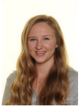
Our Year 1/2 Team:
Mrs Bates
Monday & Tuesday
Miss Balcombe
Wednesday – Friday
Trainee teacher: Mrs Bowe
Teaching Assistants: Miss Wilson, Miss Gavin, Miss Kratus and Mrs Lepczynska

Slide 3
Expectations in Year 1/2:
Quality of work
Quality of character
Good learning habits
Motivation

Slide 4
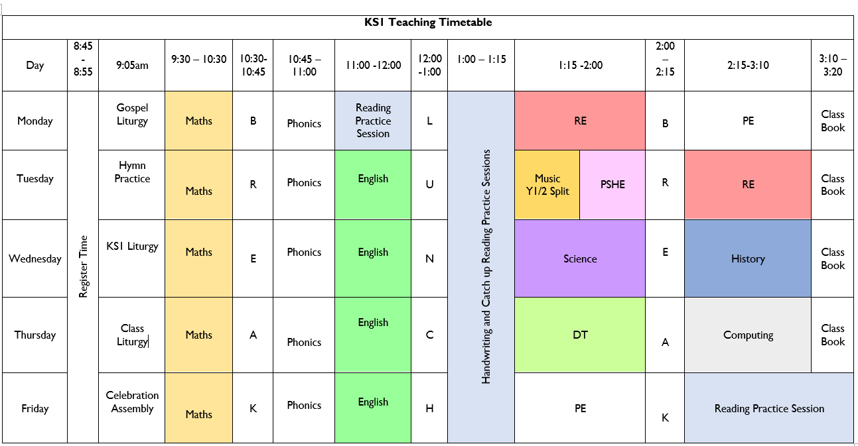
Timetable: Busy, busy, busy ☺

Slide 5
Other teacher lead activities:
PPA: Planning, Preparation and Assessment
Music teaching – Split Y1 (Miss Doherty and Mrs Bates) and Y2 (Mr Edge)

Slide 6
Equipment:
PE Kits
PE: Monday and Fridays
Please ensure that PE kits are in school at all times. Children need a white T-shirt, shorts, jogging bottoms and a sweatshirt for cooler weather. A carrier bag for muddy trainers is useful. We will send PE kits home at the end every week to be washed.
Water Bottle ~ Daily
Reading Diary and book ~ Daily

Slide 7
Weekly Homework:
Timestables ~ 10 minutes daily – 2s, 5s and 10s
Daily reading up to 15 minutes
Weekly spellings to learn ~ Tested on a Friday

Slide 8
Reading:
Regular reading for pleasure is key – independent and to an adult if possible!
Read whatever captures them
Read a mix of fiction/non-fiction if possible
Read to them too
Record in planner
READING PRACTICE SESSIONS

Slide 9
New Reading Records
Spellings
Reading Record
Passwords and usernames

Slide 10
Contact with Class Teachers:
Email address:
Mrs Bates:
laura.bates@st-augustines.nottingham.sch.uk
Miss Balcombe:
elizabeth.balcombe@st-augustines.nottingham.sch.uk

Slide 11
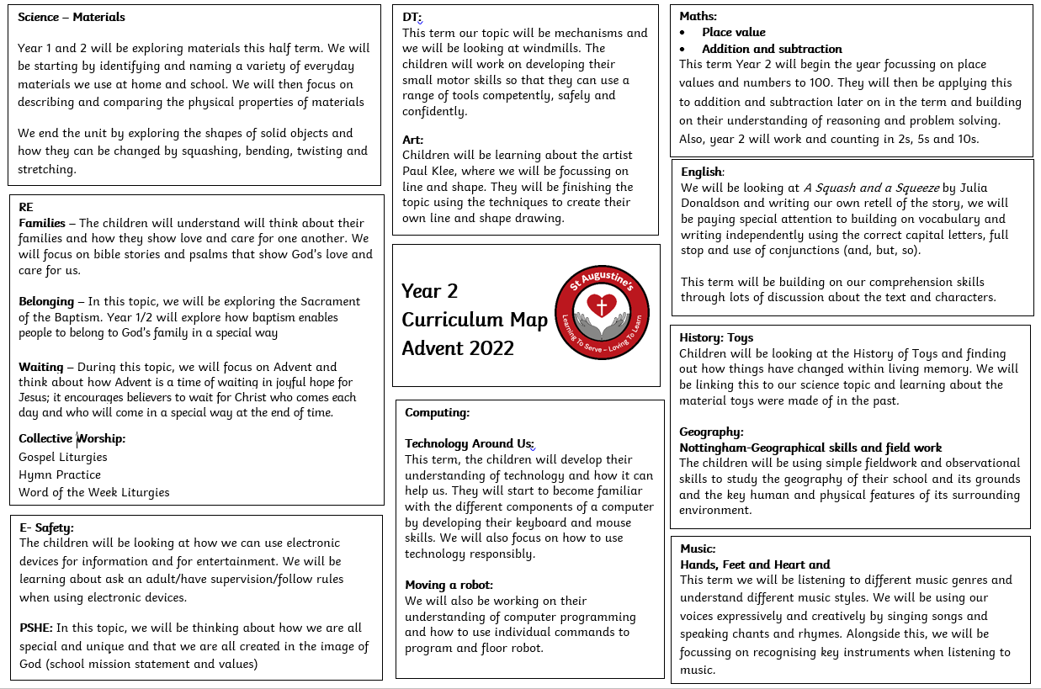
Curriculum Map Advent Term

Slide 12
Twitter
Remember to follow our Twitter page to keep you up to date with our class activities.
Please follow our class Twitter Handle @staugustinesNG3
Please be reassured that all Tweets will be inline with the school Twitter policy and GDPR requirements.

Slide 13
Questions?

