Slide 1
Meet the TeacherS
SEPTEMBER 2022
Y3

Slide 2
Expectations in Year 3:

Slide 3
Our Learning to Serve promises

Slide 4
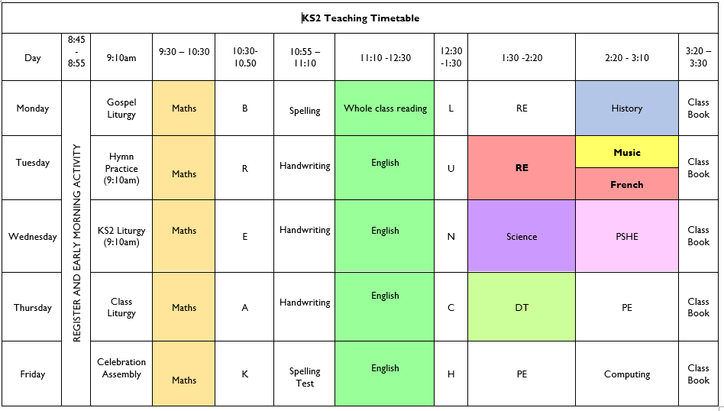
Timetable: Busy, busy, busy ☺

Slide 5
Other teacher lead activities:
PPA: Planning, Preparation and Assessment (Tuesday afternoon)
ECT Time Wednesday morning
PE- Thursday and Friday

Slide 6
Equipment:
PE Kits
Please ensure that PE kits are in school at all times. Children need a white T-shirt, shorts, jogging bottoms and a sweatshirt for cooler weather. PE kits can be taken home at the end every week to be washed.
Water Bottle ~ Daily
Reading Diary ~ Daily
KS2 Snacks- Break

Slide 7
Weekly Homework:
1 x Math Homework- 15 minutes
1 x English Homework- 15 minutes
TTRockstars ~ 10 minutes daily
Daily reading up to 15 minutes
Weekly spellings to learn ~ Tested on a Friday

Slide 8
Reading:
Regular reading for pleasure is key – independent and to an adult if possible!
Read whatever captures them
Read a mix of fiction/non-fiction if possible
Read to them too
Record in planner
Read 5 x a week at least
WHOLE CLASS READING based on class novel and reading comprehension work

Slide 9
New School Planners
Messages to school
Messages from school
Reminders of school events
Reminders of things to bring into school
General use by children for their personal events
Spellings
Reading Record
Passwords and usernames

Slide 10
Contact with Class Teachers:
Email address:
Rosalia.szarvas-jones@st-augustines.Nottingham.sch.uk

Slide 11
Curriculum Map Advent Term

Slide 12
Twitter
Remember to follow our Twitter page to keep you up to date with our class activities.
Please follow our class Twitter Handle @staugustinesNG3
Please be reassured that all Tweets will be inline with the school Twitter policy and GDPR requirements.

Slide 13
Questions?

