Slide 1
Meet the TeacherS
SEPTEMBER 2022
Y4

Slide 2
Our Year 4 Class:
Miss Rice-Allen (Monday, Tuesday, Wednesday)
Mrs Rice (Wednesday, Thursday, Friday)

Slide 3
Expectations in Year 4:

Slide 4
Our Learning to Serve promises

Slide 5
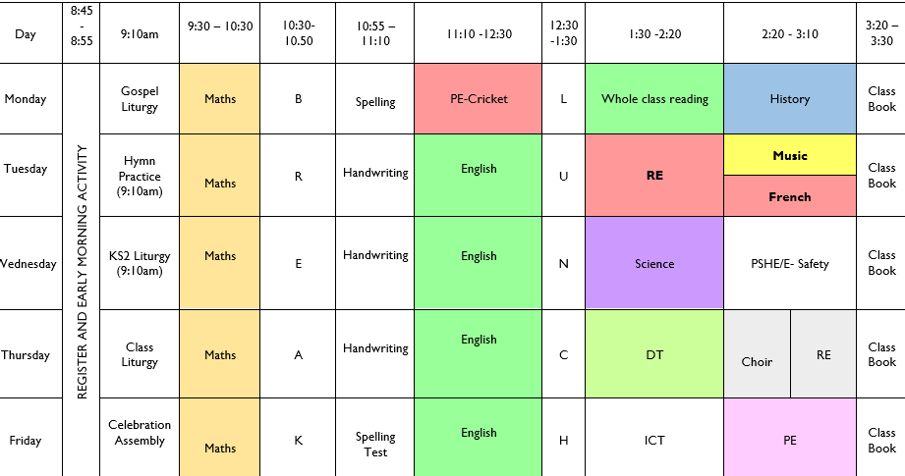
Timetable: Busy, busy, busy ☺

Slide 6
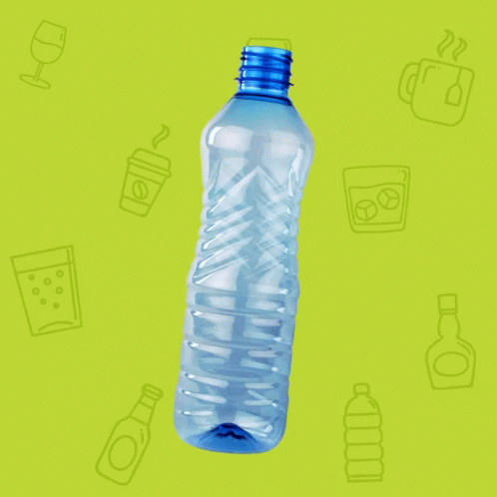
Equipment:
PE Kits
Please ensure that PE kits are in school at all times. Children need a white T-shirt, shorts, jogging bottoms and a sweatshirt for cooler weather. PE kits can be taken home at the end every week to be washed ( MONDAY and FRIDAY – PE lessons)
Water Bottle ~ Daily
Reading Diary ~ Daily
KS2 Snacks- Break

Slide 7
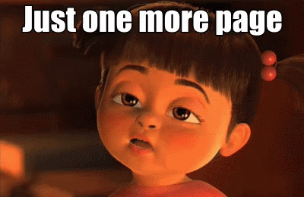
Weekly Homework:
1 x Math Homework- 15 minutes (out on Friday, due Wednesday)
1 x English Homework- 15 minutes minutes (out on Friday, due Wednesday)
TTRockstars/ Multiplication checker ~ 10 minutes daily
Daily reading up to 15 minutes
Weekly spellings to learn ~ Handed out Monday, tested on a Friday

Slide 8
Y4 MTC- multiplication tables check
Strong focus on times tables in maths lessons, ensuring that children can take the Multiplication Times Table Check (MTC) with confidence.
The National Curriculum states that by the end of Year 4, pupils should know their times table facts up to 12 x 12. The assessment has been introduced to make sure that schools have a strong focus on this objective, and to help schools identify children who are finding their times tables tricky.

Slide 9
Y4 MTC- multiplication tables check
What will the assessment look like?
The MTC is an online assessment, to be taken on a computer or tablet. e.g. 7 × 8 = ?
There will be no inverse questions, such as 7 × ? = 56.
There are 25 questions in total. Children get 6 seconds to type in their answerThe test should take no longer than 5 minutes. The test will have an emphasis on the 6, 7, 8, 9 and 12x tables, as these are judged to be the harder times tables.
June 2023
https://www.timestables.co.uk/multiplication-tables-check/

Slide 10
Y4 MTC- multiplication tables check

Slide 11
Reading:
Regular reading for pleasure is key – independent and to an adult if possible!
Read whatever captures them
Read a mix of fiction/non-fiction if possible
Read to them too
Record in planner
Read 5 x a week at least
Library books
WHOLE CLASS READING based on a novel and reading comprehension work

Slide 12
New School Planners
Messages to school
Messages from school
Reminders of school events
Reminders of things to bring into school
General use by children for their personal events
Spellings
Reading Record
Passwords and usernames

Slide 13
Contact with Class Teachers:
Email address:

Slide 14
Curriculum Map Advent Term

Slide 15
Twitter
Remember to follow our Twitter page to keep you up to date with our class activities.
Please follow our class Twitter Handle @staugustinesNG3
Please be reassured that all Tweets will be inline with the school Twitter policy and GDPR requirements.

Slide 16
Questions?

