Slide 1
Meet the Teacher
SEPTEMBER 2022
Y2

Slide 2
Our Year 2 Team:
Mr Edge
Mrs Lepczynska (Monday and Tuesday)
Mrs Powell (Wednesday to Friday)

Slide 3
Expectations in Year 1/2:
Quality of work
Quality of character
Good learning habits
Motivation

Slide 4
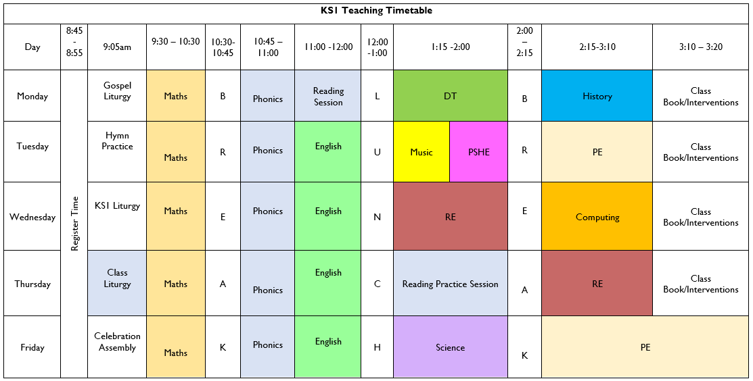
Timetable: Busy, busy, busy ☺

Slide 5
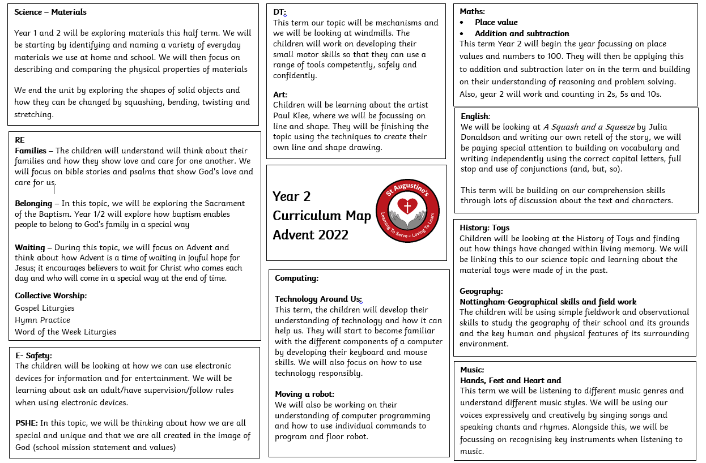
Curriculum Map Advent Term

Slide 6
Other teacher lead activities:
PPA: Monday
Coordinator Release - Friday

Slide 7
Equipment:
PE Kits
Please ensure that PE kits are in school at all times. Children need a white T-shirt, shorts, jogging bottoms and a sweatshirt for cooler weather. A carrier bag for muddy trainers is useful. We will send PE kits home at the end every week to be washed.
Water Bottle ~ Daily
Reading Diary ~ Daily

Slide 8
Weekly Homework:
Weekly Spellings (Receive Monday – Test Friday)
Weekly maths Facts (Receive Monday – Test Friday)
Reading – Three times a week
Friday Homework – Related to one subject for you to see how your child is progressing. If your child cannot complete their homework on their own. Send a note and don’t worry. They might need reteaching.

Slide 9
Reading:
New Reading books
Each book will be kept for a minimum of 1 week.
Repeated practice to develop fluency.
Words and sounds inside the front cover to practice reading (and spelling).
Develop fluency so they can read with intonation.

Slide 10
Reading:
Also;
Read whatever captures them
Read a mix of fiction/non-fiction if possible
Read to them too
Record in reading diary

Slide 11
New School Reading Diary
Messages to school
Reading Record
Passwords and usernames (Numbots and TTrockstars)

Slide 12
Contact with Class Teachers:
I’m here most day 7-5. Contact me with any worries. I’m not as scary as I look.
Contact:
Note in reading diary
Ask at the door
Email: admin@st-augustines.nottingham.sch.uk and put my name on

Slide 13
Questions?

