Slide 1
Meet the Teacher
SEPTEMBER 2022
Y1

Slide 2
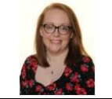
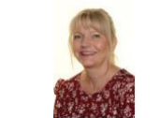
Year 1
Miss Littlewood
Weds, Thurs, Fri
Miss Doherty
Mon, Tues, Weds
Miss Hunter
Thurs & Fri
Mrs Austin
Mon am, Tues am, Weds am

Slide 3
Expectations in Year 1:
Quality of work
Quality of character
Good learning habits
Motivation

Slide 4
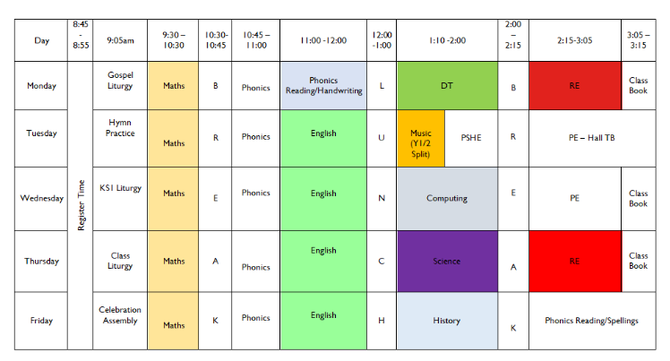
Timetable: Busy, busy, busy ☺

Slide 5
Curriculum Map Advent Term

Slide 6
Phonics
New scheme
At the moment getting the children to be able to read is the most important fundamental skill as it opens up a new world for them.
June 2023 Government Phonic Screening Test
https://www.littlewandlelettersandsounds.org.uk/resources/for-parents/

Slide 7
New Reading books
Each book will be kept for a minimum of 1 week.
Repeated practice to develop fluency.
Words and sounds inside the front cover to practice reading (and spelling).
Develop fluency so they can read with intonation.

Slide 8
Reading:
Also;
Read whatever captures them
Read a mix of fiction/non-fiction if possible
Read to them too
Record in reading diary

Slide 9
Weekly Homework:
Numbots – 5 mins
Spellings sent home on a Monday and a quiz on Friday
READ!

Slide 10
New School Reading Diary
Messages to school
Reading Record
Passwords and usernames (Numbots and TTrockstars)

Slide 11
Equipment:
PE Kits
Please ensure that PE kits are in school at all times. Children need a white T-shirt, shorts, jogging bottoms and a sweatshirt for cooler weather. A carrier bag for muddy trainers is useful. We will send PE kits home at the end every week to be washed.
PE Tuesday and Wednesday
Water Bottle ~ Daily
Reading Diary ~ Daily
Bag

Slide 12
Contact with Class Teachers:
I’m here most day 7-5. Contact me with any worries. I’m not as scary as I look.
Contact:
Note in reading diary
Ask at the door
Email: admin@st-augustines.nottingham.sch.uk and put Miss Littlewood/Miss Doherty

Slide 13
Twitter
Remember to follow our Twitter page to keep you up to date with our class activities.
Please follow our class Twitter Handle @staugustinesNG3
Please be reassured that all Tweets will be inline with the school Twitter policy and GDPR requirements.

Slide 14
Questions?

