Slide 1
Meet the Teacher
SEPTEMBER 2022
F2 - Reception

Slide 2
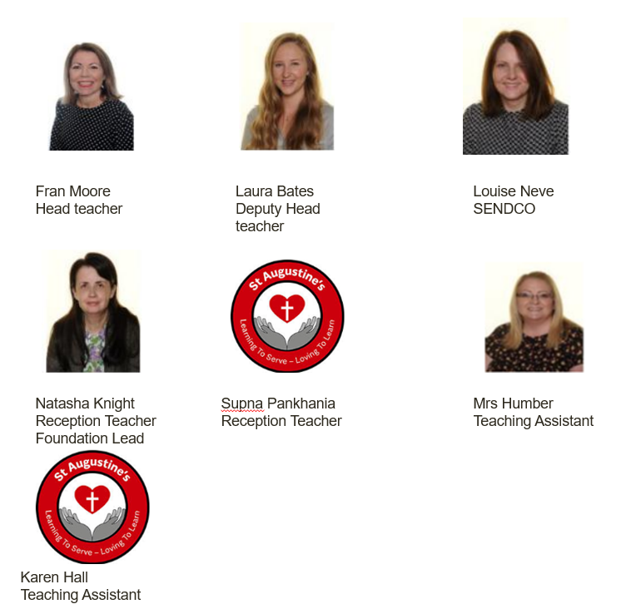
Our Year F2 / Reception (Foundation Stage Team):

Slide 3
Expectations in Year F2:
Quality of work
Quality of character
Good learning habits
Motivation

Slide 4
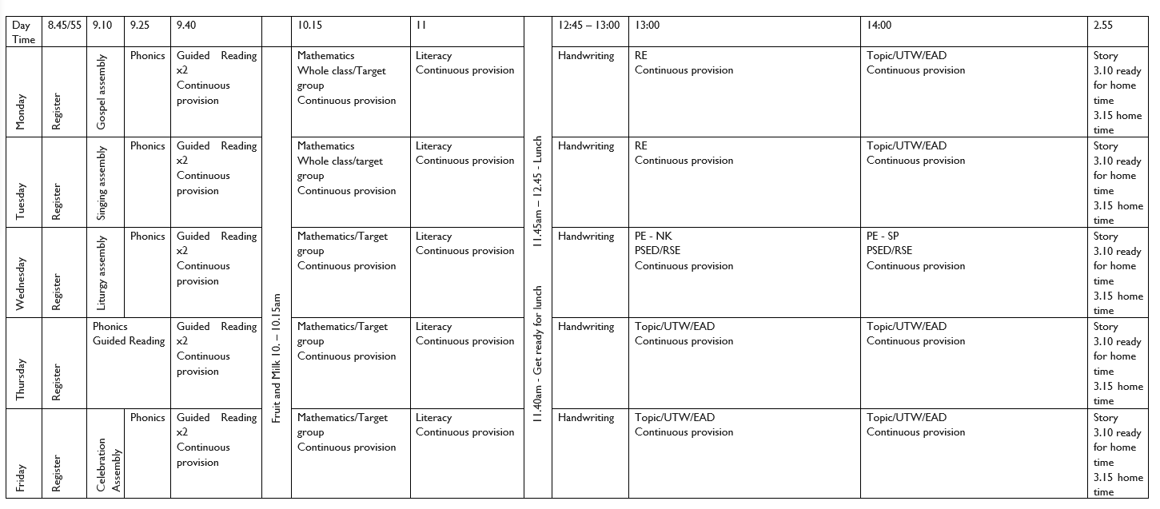
Timetable: Busy, busy, busy ☺

Slide 5
Other teacher lead activities:
PPA: Planning, Preparation and Assessment
PE: Wednesday – Leave in school

Slide 6
Equipment:
PE Kits
Please ensure that PE kits are in school at all times. Children need a white T-shirt, shorts, jogging bottoms and a sweatshirt for cooler weather. A carrier bag for muddy trainers is useful. We will send PE kits home at the end every week to be washed.
Water Bottle ~ Daily – Name label
Lunch Box – Name label
Jumper / Cardigan – Name label
Reading Diary and Folder ~ Daily
FS2 Snacks – Milk and fruit

Slide 7
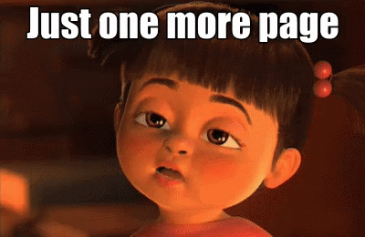
Weekly Homework:
Little Wandle – Guided Reading Book
Daily reading up to 15 minutes
Share at home book
Please write a comment and let us know how your child has got on with the homework/reading
Please bring a bag to carry your homework/book

Slide 8
School Ready:
• Practice writing their name.
• Reading and talking about books together.
• Going to the toilet independently.
• Putting on their coat.
• Fastening buttons and zips.
• Using a knife and fork.

Slide 9
Reading:
Regular reading for pleasure is key – weekly share at home book – For you to read and share with your child.
Read whatever captures them
Read a mix of fiction/non-fiction if possible
Record in planner

Slide 10
New School Planners
Messages to school
Messages from school
Reminders of school events
Reminders of things to bring into school
General use by children for their personal events
Reading Record
Passwords and usernames

Slide 11
Contact with Class Teachers:
Email address:
Natasha.knight@st-augustines.Nottingham.sch.uk
Supna.pankhania@st-augstines.Nottingham.sch.uk

Slide 12
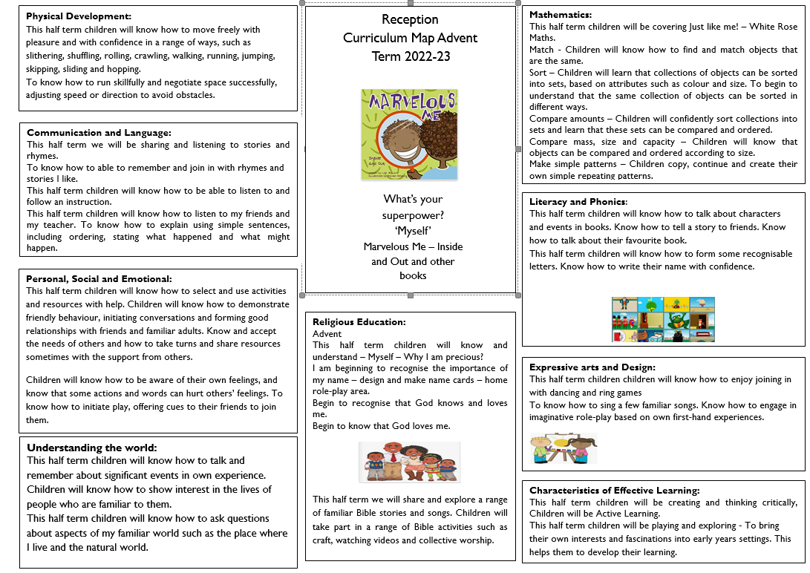
Curriculum Map Advent Term

Slide 13
Twitter
Remember to follow our Twitter page to keep you up to date with our class activities.
Please follow our class Twitter Handle @staugustinesNG3
Please be reassured that all Tweets will be inline with the school Twitter policy and GDPR requirements.

Slide 14
Questions?

