Slide 1
Meet the Teacher
SEPTEMBER 2022
Year 6

Slide 2
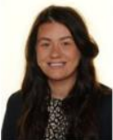
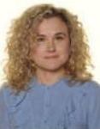
Our Year 6 Team:
Miss Jones
Mrs Feliszek

Slide 3
Expectations in Year 6:
Quality of work
Quality of character
Good learning habits
Motivation

Slide 4
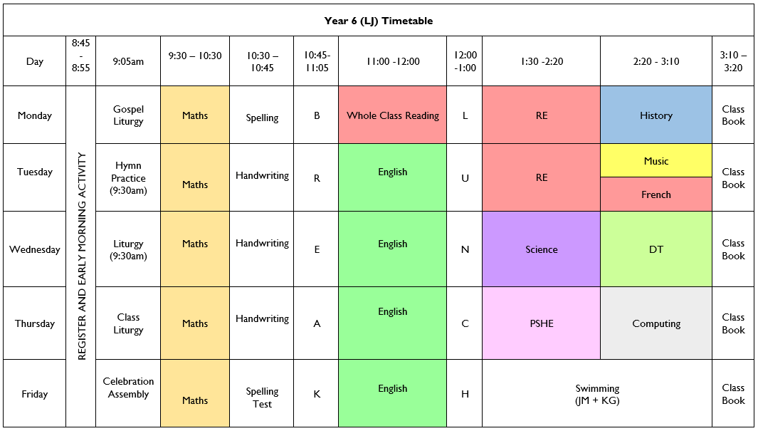
Timetable: Busy, busy, busy ☺

Slide 5
Other teacher lead activities:
PPA: Planning, Preparation and Assessment
THURSDAYS PSHE & Computing – Mrs Feliszek

Slide 6
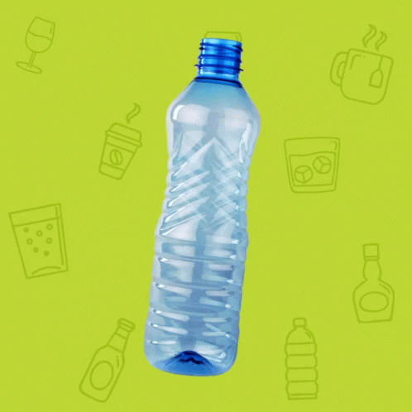
Equipment:
PE Kits
Please ensure that PE kits are in school at all times. Children need a white T-shirt, shorts, jogging bottoms and a sweatshirt for cooler weather. We will send PE kits home at the end every week to be washed.
Water Bottle - Daily
Reading Diary - Daily
KS2 Snacks

Slide 7
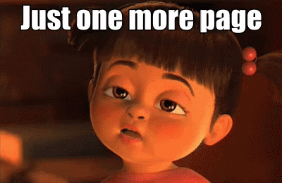
Weekly Homework:
TTRockstars ~ 10 minutes daily
Daily reading up to 15 minutes ~ 4 times per week, signed by an adult/older sibling
Weekly spellings to learn ~ Tested on a Friday
Maths & English homework weekly

Slide 8
Reading:
Regular reading for pleasure is key – independent and to an adult if possible!
Read whatever captures them
Read a mix of fiction/non-fiction if possible
Read to them too
Record in planner
WHOLE CLASS READING based on class novel and reading comprehension work

Slide 9
New School Planners
Messages to school
Messages from school
Reminders of school events
Reminders of things to bring into school
General use by children for their personal events
Spellings
Reading Record
Passwords and usernames

Slide 10
SATs
Weekly homework will support SATs preparation
Fast paced quality first teaching
Intervention with Mrs Feliszek
Booster Group after school with Miss Jones and Mr Napthine starting after October half term.
Weekly arithmetic tests

Slide 11
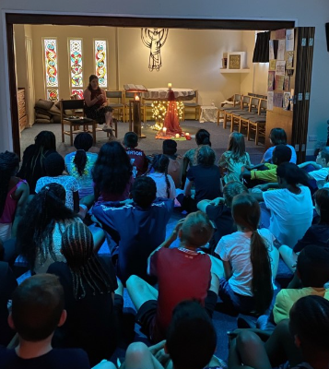
CRICH TRIP
21st – 23rd November 2022
Parents Meeting – 12th September 3:45pm – Miss Jones’ Classroom - More information

Slide 12
Contact with Class Teacher:
Email address:
lydia.jones@st-augustines.nottingham.sch.uk

Slide 13
Curriculum Map Advent Term
Maths
Place Value
Four Operations
English
Secrets of a Sun King
RE
Ourselves
Judaism
Life Choices
Hope
History
Ancient Egypt
SCIENCE
Life Cycles
PE
Swimming
FRENCH
Classroom Objects
Writing sentences
MUSIC
Happy – Pharrell Williams
DT
Building bridges

Slide 14
Twitter
Remember to follow our Twitter page to keep you up to date with our class activities.
Please follow our class Twitter Handle @staugustinesNG3
Please be reassured that all Tweets will be inline with the school Twitter policy and GDPR requirements.

Slide 15
Questions?

