Slide 1
Meet the Teacher

Slide 2
A bit about me
Nearly 10 years teaching – lots of different things before
Music
Reading/Writing/English
Football

Slide 3
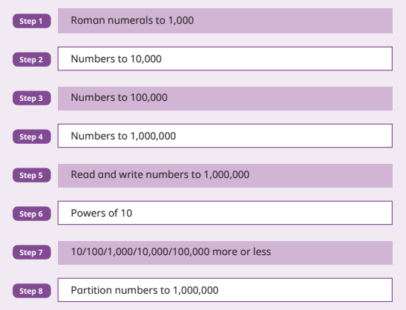
Maths Curriculum – Year 5

Slide 4
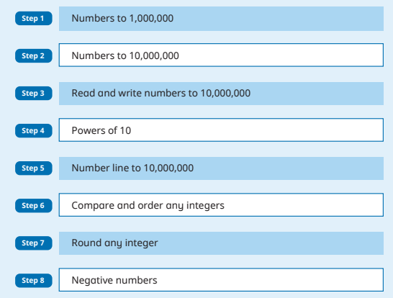
Maths Curriculum – Year 6

Slide 5
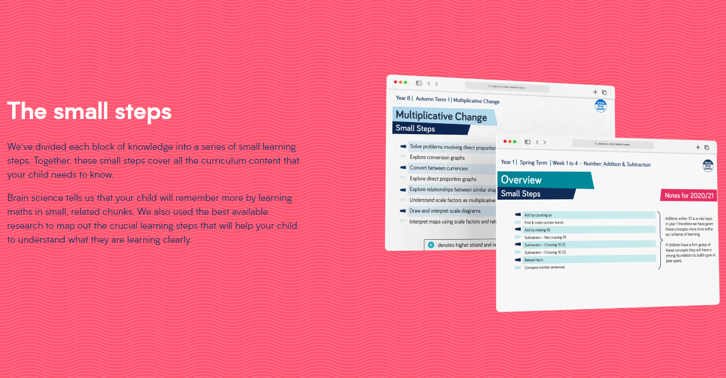
www.whiterosemaths.com
Parents page with information about all the blocks of learning

Slide 6
English – Current Topic
Secrets of a Sun King by Emma Carroll
Setting descriptions (3 wks)
Diary (3 wks)

Slide 7
RE - ourselves
Talents / Qualities
Scripture work
Link to gospel values

Slide 8
Reading Diaries – Reading at home
Reading diaries – expectations
Reading at home – VIPERS
Dual-language books

Slide 9
Timetable

Slide 10
Uniform
Expectations in reading diaries

Slide 11
Spellings
Why those words?
How can we improve?

Slide 12
Any Questions?

